Slide 1
TIMES SHIKSHA SHASTRI MAHAVIDHYALAYA
CHAK 10 HMH TIBBI-GURUSAR ROAD KARTARPURA COLONY HANUMANGARH TOWN
MOB-94145-02024 , 94140-95702
Times Shiksha Shastri Mahavidhyalya” college located in Hanumangarh Town, Rajasthan. This college was established in the academic session 2007–08. The college is recognized by NCTE, Rajasthan Government, and JRR Sanskrit University. It conducts teacher training B.Ed. Two Year course. The college was established with the Aim of promoting Sanskrit education in higher education.

Slide 2
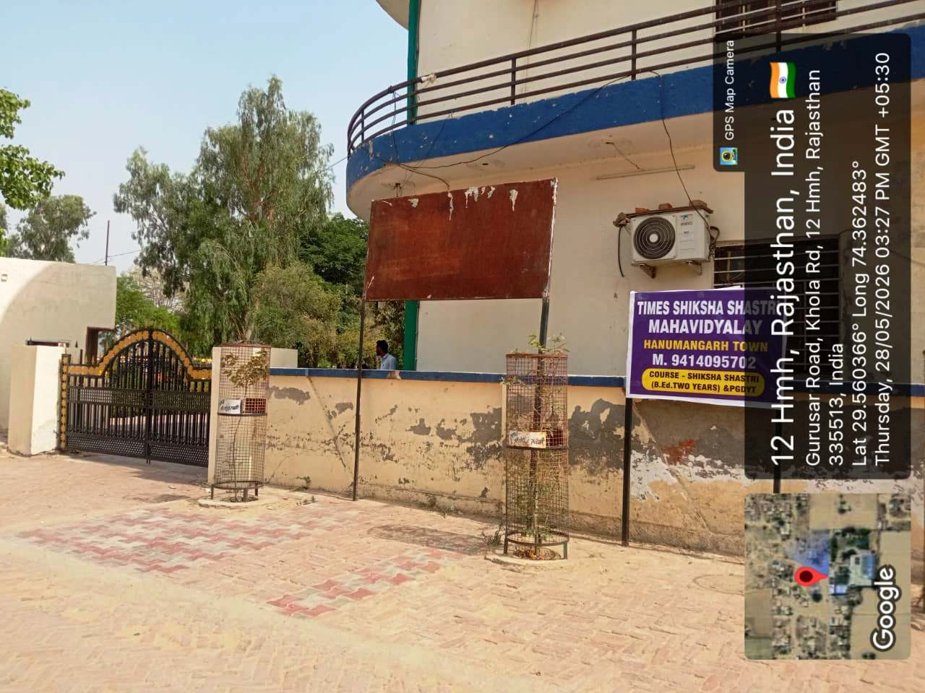

Slide 3
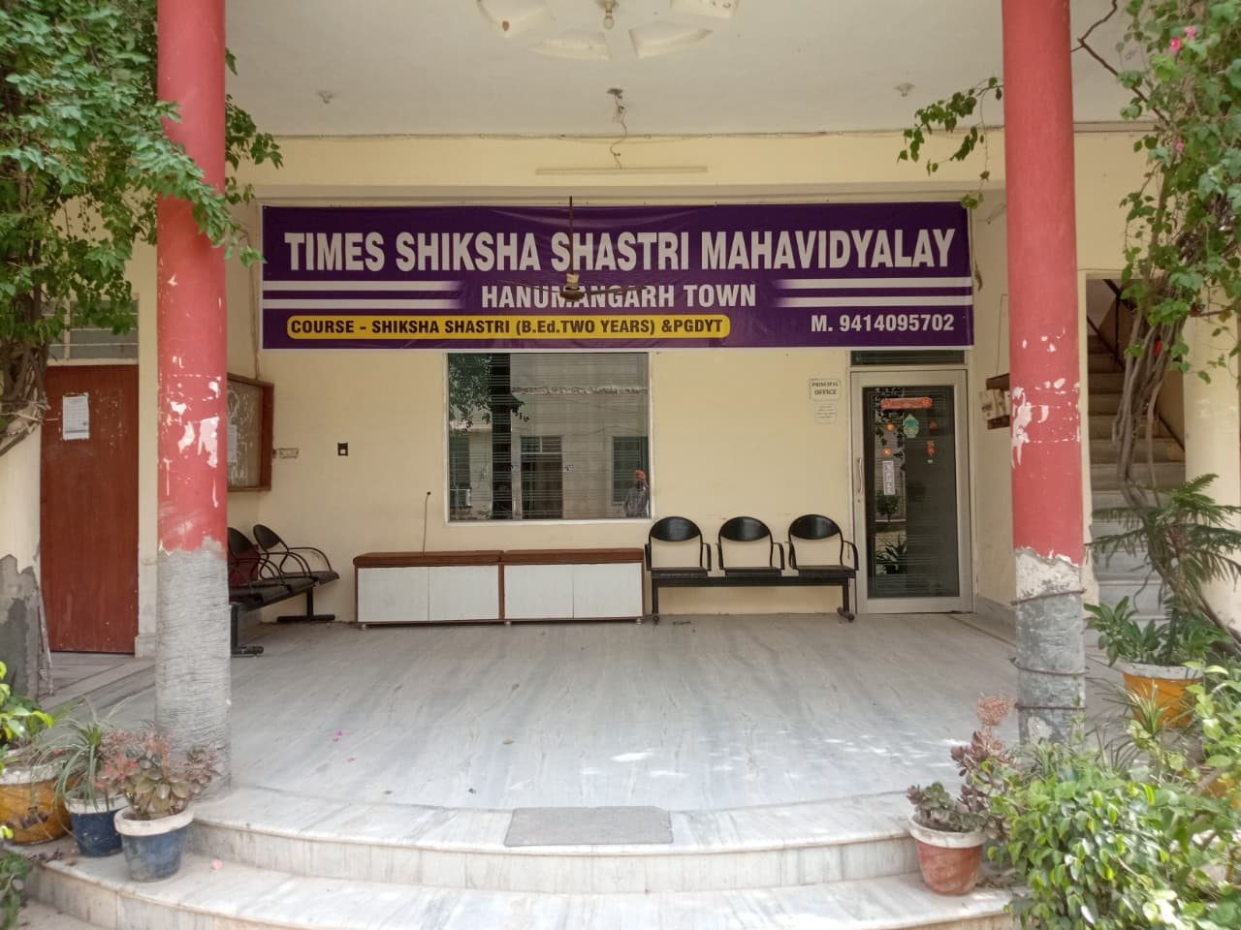

Slide 4
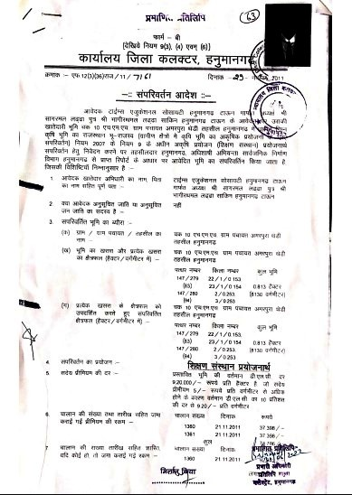
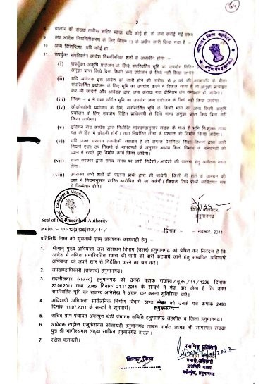

Slide 5
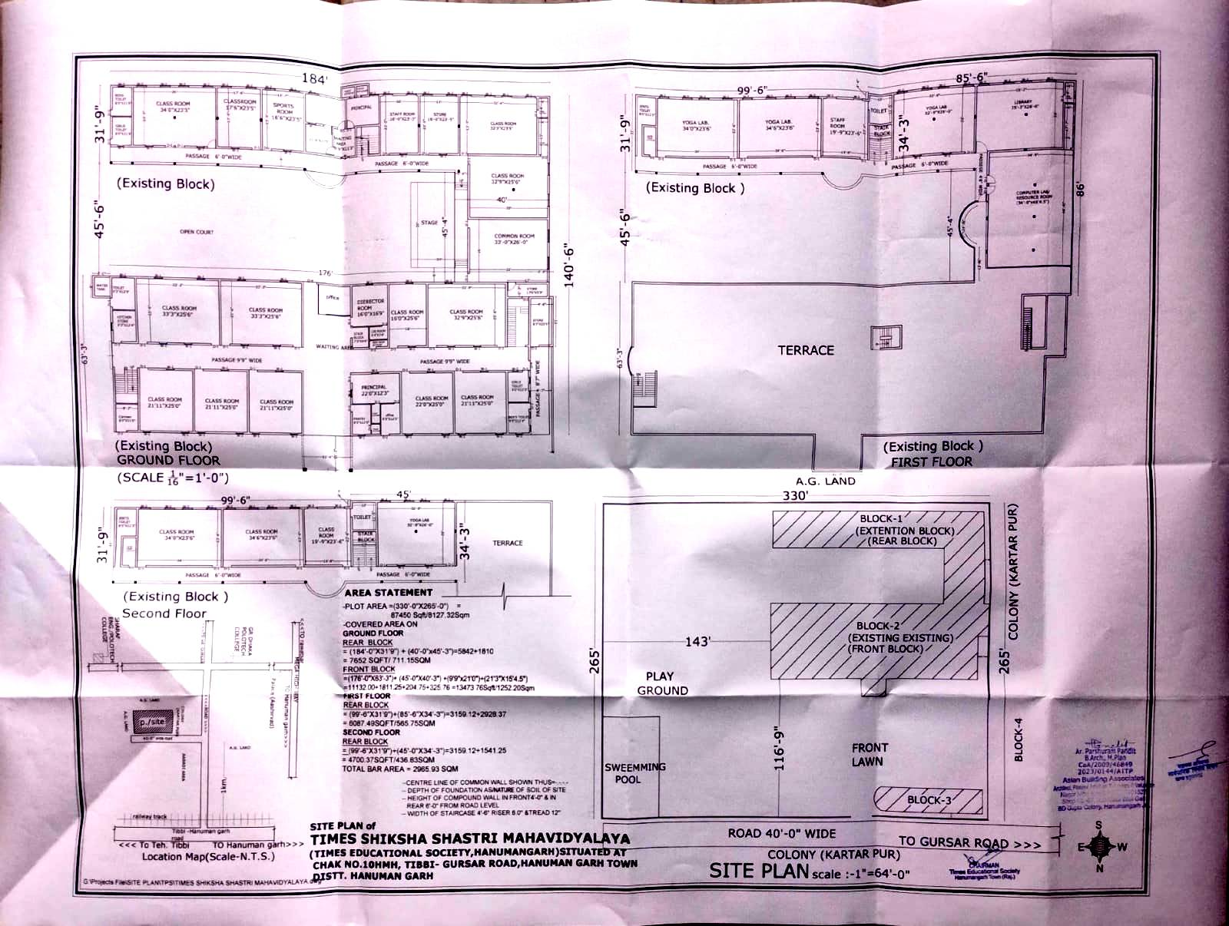

Slide 6
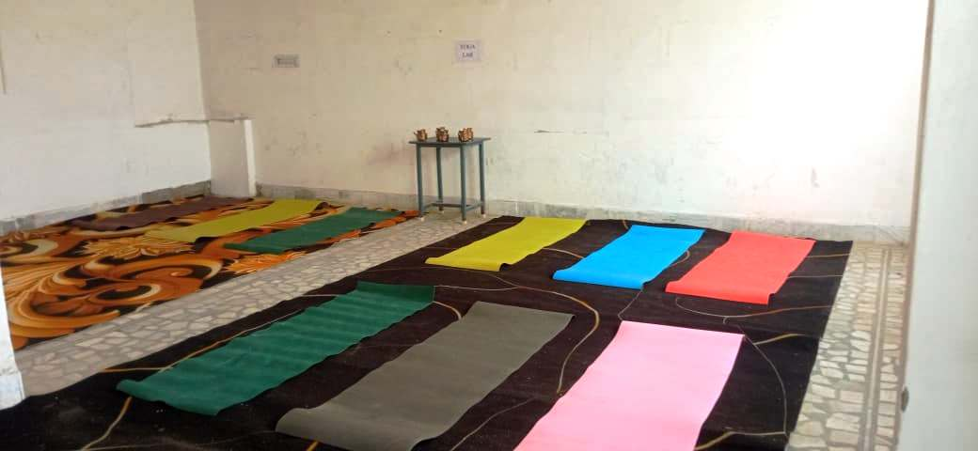
YOGA LAB

Slide 7
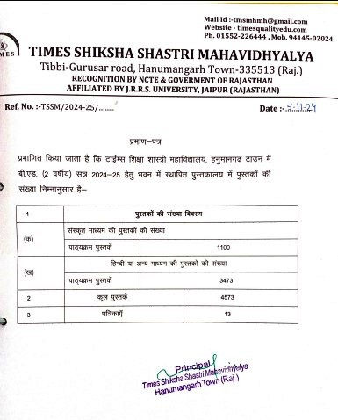
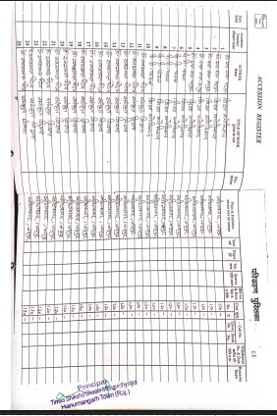
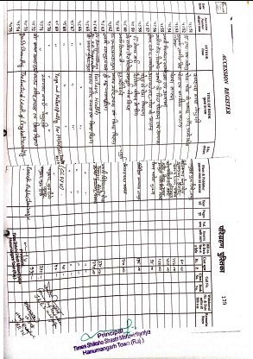

Slide 8
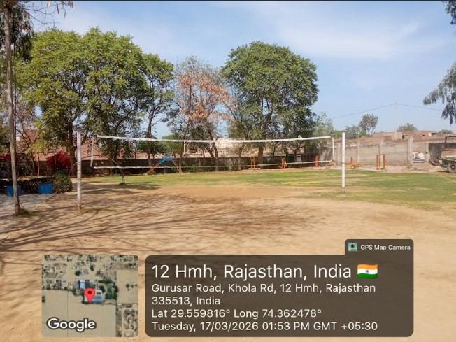

Slide 9
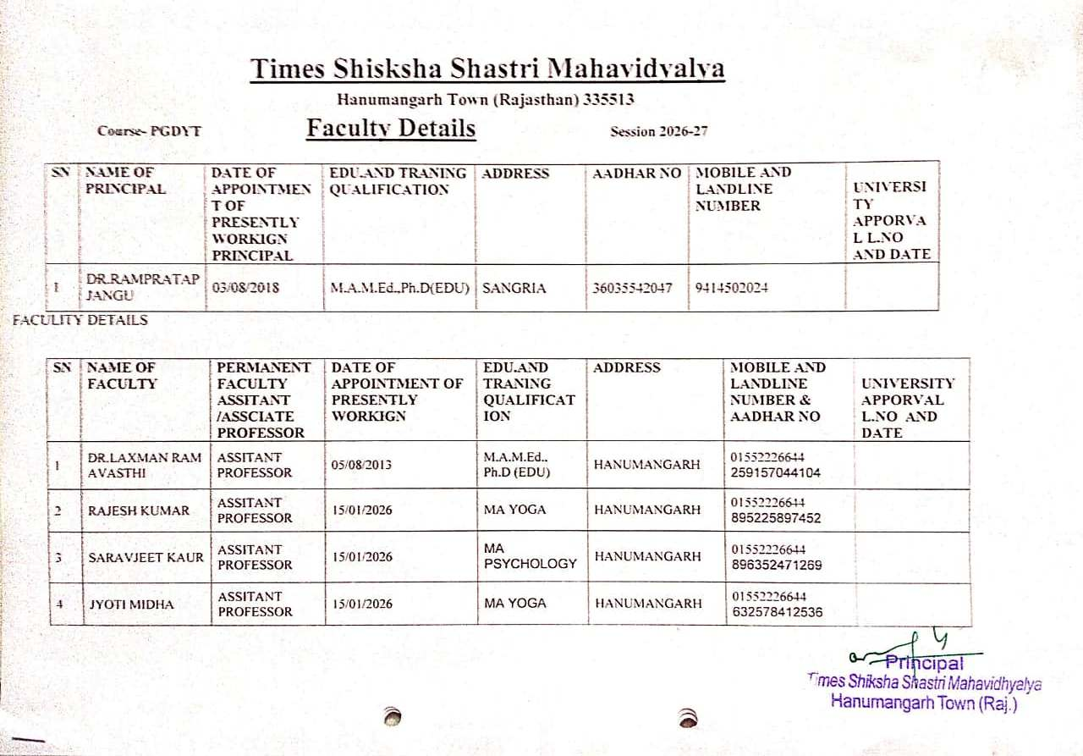

Slide 10
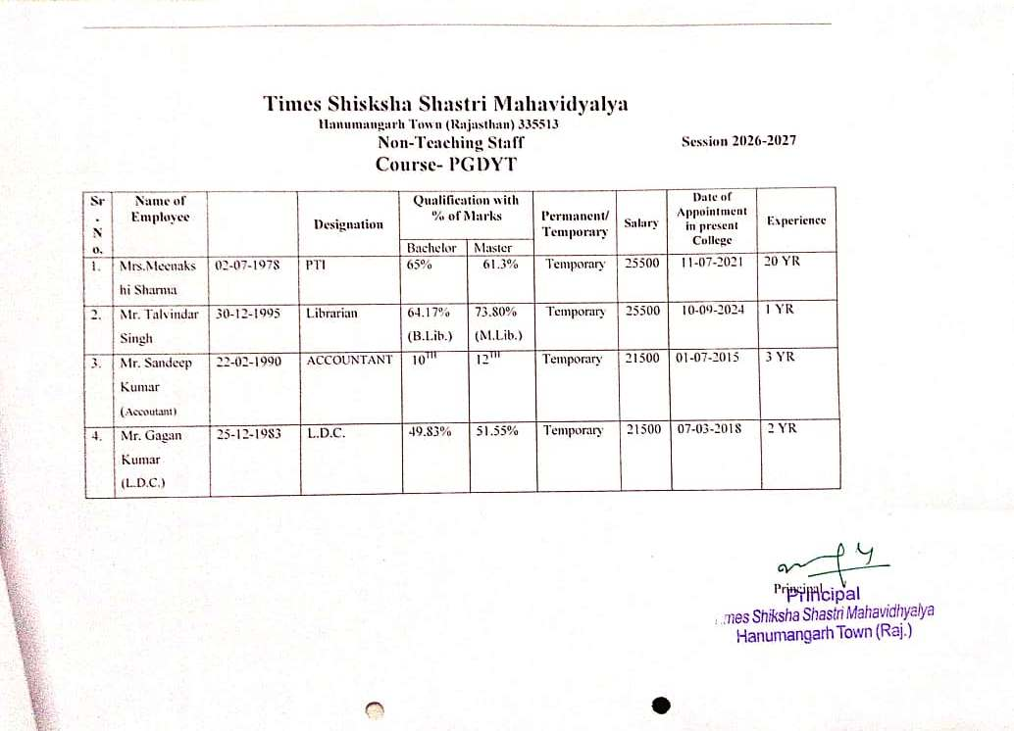

Slide 11
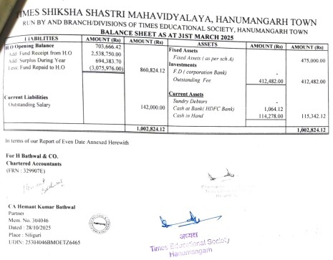
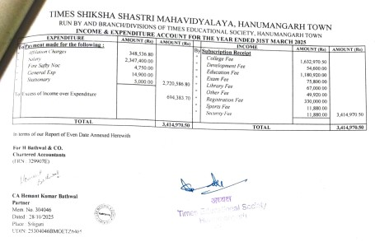
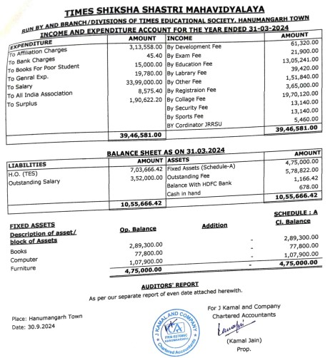
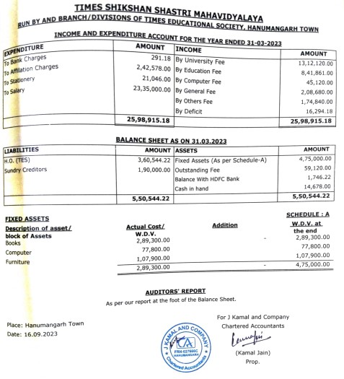

Slide 12
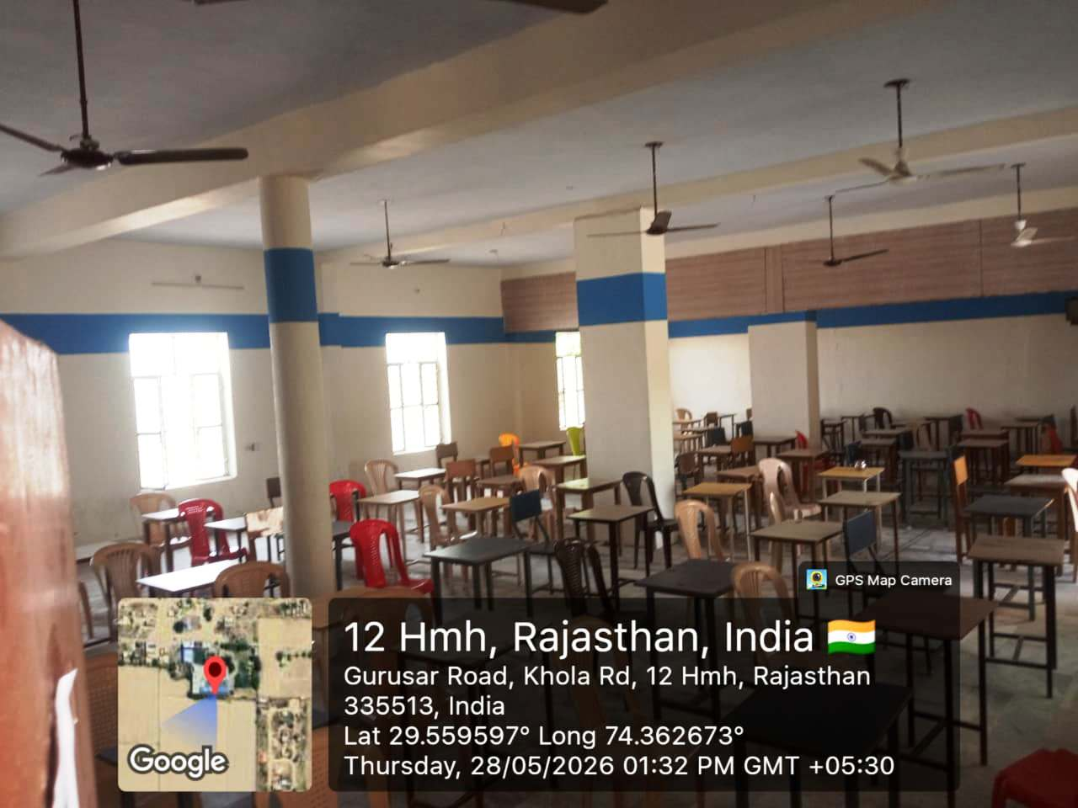
MULTIPURPOSE HALL

Slide 13
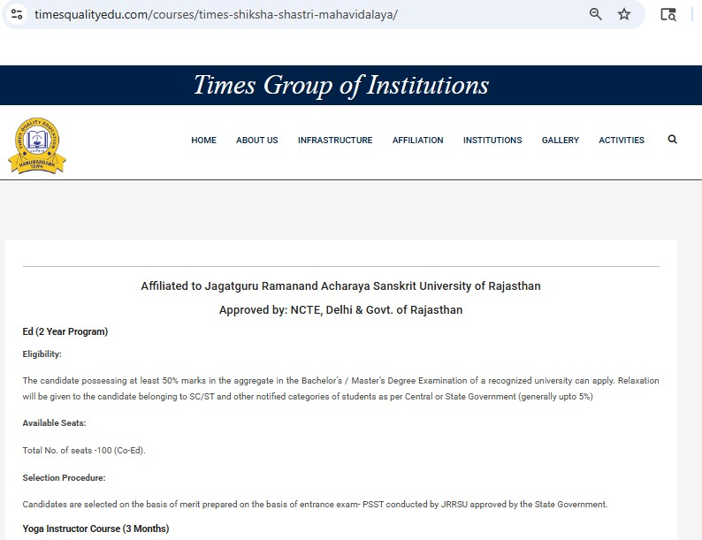
timesqualityedu.com

